Slide 1
Characters Revealed
PRIDE AND PREJUDICE
IGCSE English

Slide 2
Narrator
Jane Austen is an omniscient narrator.
This means she is all-knowing
She can reveal the thoughts and feelings of all characters
However, she focuses mainly on Elizabeth, and we see the world as the heroine sees it.

Slide 3
Satire
Many critics consider the novel a satire, which, in general terms, is a literary work that uses irony and humour to expose human or social faults. Thus, Lydia embodies vanity, Wickham dishonesty, Mr. Collins obsequiousness (servility), and Mrs. Bennet a multitude of follies. Austen does not tear down country life or folk; rather, she directs the reader's gaze to some of the human imperfections that threaten the virtues of her culture.

Slide 4
Presentation of characters
Description – What they look like, physical descriptions, and so on
Dialogue – What they say and what other characters say about them
Actions – How they behave and how they react to situations
Thoughts and feelings – What they really feel

Slide 5
Consider how a character develops and changes as the novel progresses.
Can you spot the turning points?
Is the author’s description convincing?

Slide 6
The main players – first impressions
Darcy – haughty, arrogant, rich, snobby.
Elizabeth – witty, unconventional, forthright.
Bingley – charming, affable, fun, rich.
Jane – sees only good in others, not pushy.

Slide 7
Physical Description
The only character to be described in any detail (so far) is Darcy – Chapter 3
Most of our knowledge of character comes through dialogue.

Slide 8
Elizabeth
We learn more about Elizabeth in her conversation with Jane (Ch 4), and her conversation with Charlotte Lucas (Ch 6)
Jane Austen has begun to use her as a centre of consciousness.
She becomes the main character; we tend to see developments from her point of view.
Watch out for this as the novel develops.

Slide 9
She is Mr Bennet’s favourite daughter – look for evidence of this.
She likes to adopt striking and independent views.
Capable of laughing at herself, for example, after Darcy snubbed her in Chapter 3.

Slide 10
Darcy
Very proud and prejudiced. However, Bingley must be fond of him for a reason.
Appears cold and superficial, yet is taken with Elizabeth’s eyes (mentioned twice in Ch 6)
So far, the reader has no great warmth towards him.
Darcy is very much the outsider at this stage of the novel.

Slide 11
Jane and Bingley
Jane is modest and quiet. Only sees the best in everyone (which slightly annoys Elizabeth) and is very patient.
The most beautiful of the Bennet sisters – the “most beautiful creature I have beheld”, according to Bingley.
Bingley is kind and easy-going. Darcy likes the ‘easiness, openness, ductility [can be moulded, flexible] of his temper’ Ch 4.
Jane and Bingley are well matched.

Slide 12
Marriage
It wasn't until the end of the nineteenth century that married women had any rights over their property - either that which they owned at marriage or any which they acquired after marriage either by inheritance or by their own earnings. All property within marriage legally belonged to the husband. But this isn't surprising if you consider the attitude to marriage. According to Blackstone, writing in about 1765, the husband and wife were one person in law: the legal existence of the woman was suspended and incorporated into the personality of her husband. A husband could leave property to his wife in his will (because that would not take effect until after the marriage was ended by his death), but could not make a legal gift to her and was responsible for all her debts, whether contracted during the marriage or before.

Slide 13
Sample questions
6.
Either
(a) Mr and Mrs Bennett have different parental qualities. Outline their differences and state who, in your view, is presented as the better parent. Refer closely to the novel to support your
answer.
(40 marks)
Or
(b) To the modern reader the way of life of the women in Pride and Prejudice seems dull and predictable.
How far do you agree or disagree with this view?
(40 marks)

Slide 14
Homework
You have four questions.
A single paragraph is sufficient for each answer.

Slide 15
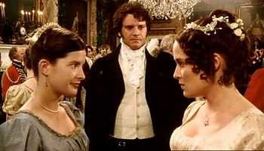
Question One
Chapter 6
What are Elizabeth’s views on love and marriage?

Slide 16
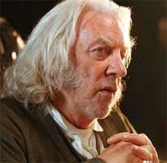
Question Two
Chapter 7
“From all that I can collect by your manner of talking, you must be two of the silliest girls in the country.” (Mr Bennet to Catherine and Lydia) Why does he say this?

Slide 17
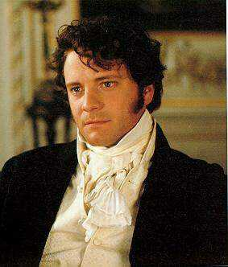
Question Three
Chapter 8
“If they had uncles enough to fill all Cheapside,” cried Mr Bingley, “it would not make them one jot less agreeable.”
“But it must very materially lessen their chance of marrying men of any consideration in the world,” replied Darcy.
Why were women so dependent on men during the Regency period?

Slide 18
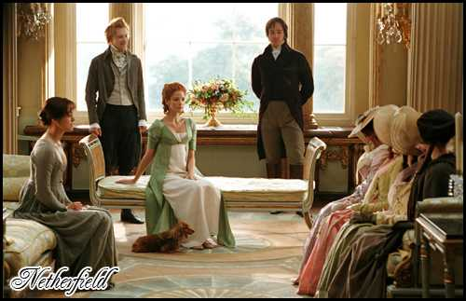
Question Four
Chapter 9
What are your impressions of Mrs Bennet in this chapter? Is Austen’s assessment of her in Chapter One correct, so far?

Slide 19
This powerpoint was kindly donated to www.worldofteaching.com
http://www.worldofteaching.com is home to over a thousand powerpoints submitted by teachers. This is a completely free site and requires no registration. Please visit and I hope it will help in your teaching.

